Slide 1
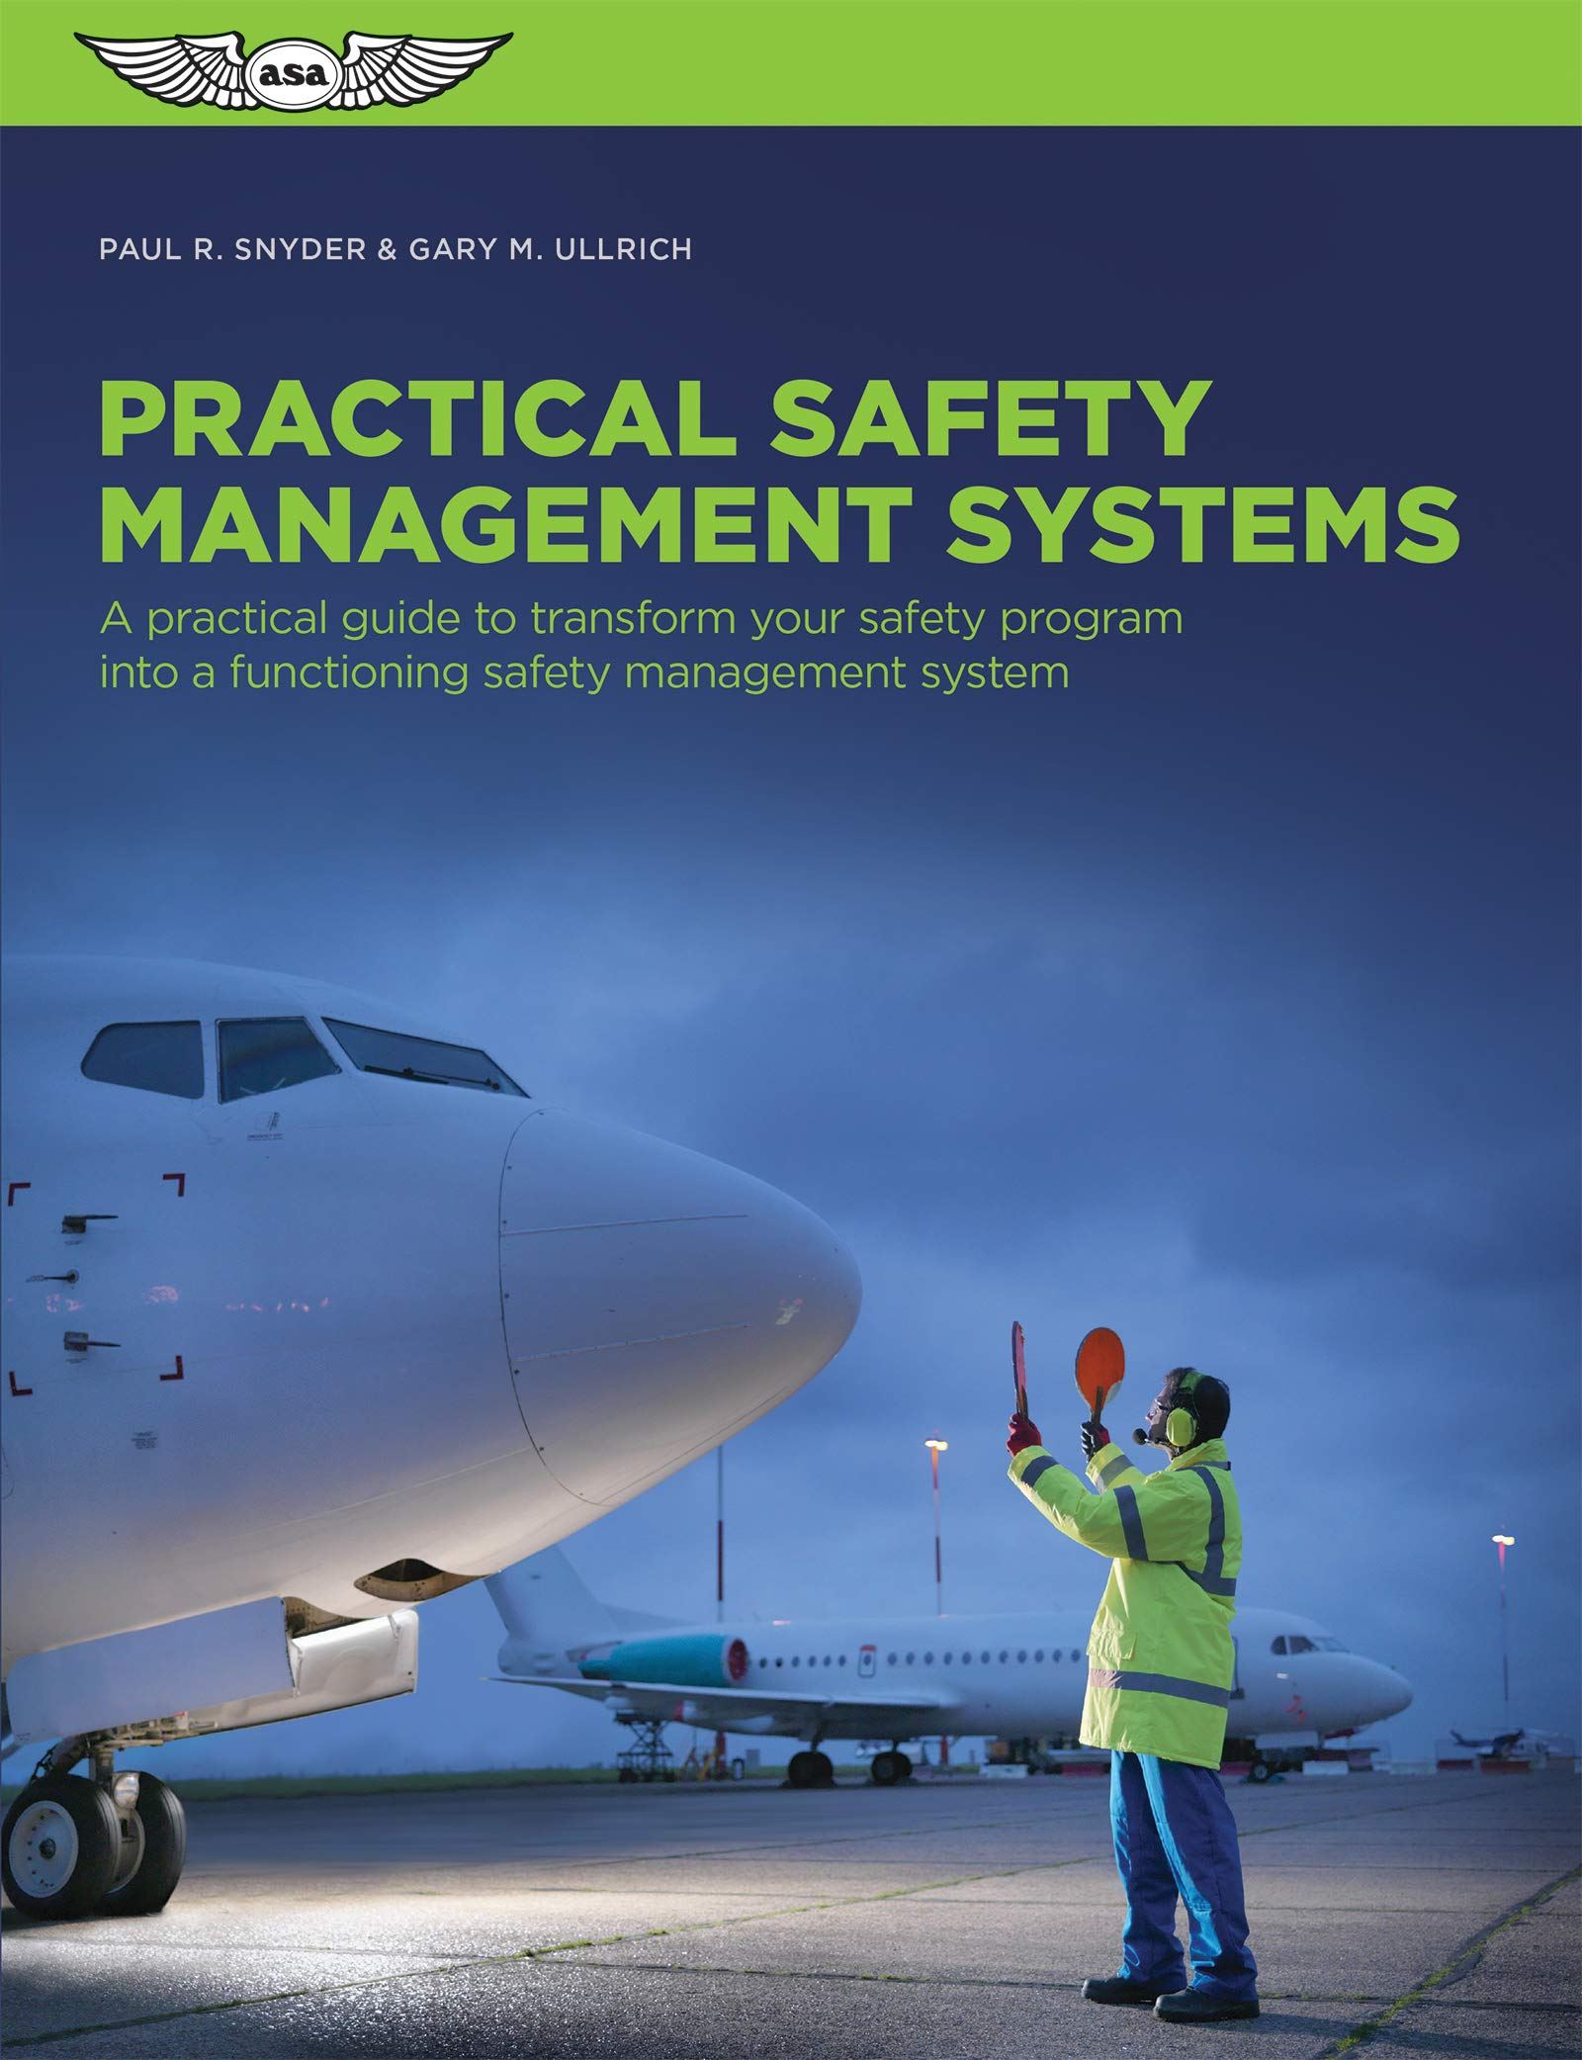

Slide 2
A Guidebook for Airport Safety Management Systems
Introduction
Airports are very important resources in the United State of American; their main function is the transportation of the people or goods internally and externally
The national aviation system has the mandate to help in providing safety measures for airports.
These safety measures have been in the airports for a long time without a proper guideline thus there have been a lot of accidents that have happened in the airports including plane crushes in the airports.

Slide 3
Airport safety management systems in the United States
The airport safety management systems of the United States were not on good standards, these led to aircraft accidents and the risk of accidents was overwhelming
This research study is going to analyze the safety measures of airports before and after providing a proper guidebook for airport safety management systems to reduce the number of accidents that occur in the airports.

Slide 4
An approach for reducing accidents and the risk of aircraft accidents
By introducing new technologies in the airports and also providing a guidebook for the airport safety management systems.
Monitoring of airports and measurement of the current situation and experience of airports.
To make and implement safety management systems which will be used to improve the safety measures of the airplane through the guidance of the national aviation body.

Slide 5
Research on the airport safety management system in the United States
The research results indicated that accidents were many before 2006 as compared to the period after 2007. A research study was done to establish the causes of aircraft accidents and the following were established.
The research done in 2003 established most of the plane crashes happen because of human error like mid-air collisions, bad weather, and technical problems from the aircraft.

Slide 6
Review of the airport safety before and after
Safety management systems before 2007 were not good as compared to the period after 2008 when the guidebook of safety management systems was put in practice.
Most of the aircraft accidents happened before 2006 and the causes were human error and other factors that could have been managed.
For example in 2000 a plane Alaska Airlines Flight 261 crashed in the Pacific Ocean due to unpredictable weather and many plane crashes were experienced in that period to 2005.

Slide 7
Analysis of safety of airports after the introduction of guidebook
The United States has safe airports that report fewer aircraft accidents because of the guidebook for safety management systems.
Human error attributed to a lot of aircraft accidents reduced.
The aircraft are subjected to much inspection with different professionals before they take off.
The Mid-air collision of airplanes that was highly experienced in 2000 was reduced.

Slide 8
Conclusion
The guidebook for the safety management systems of airplanes has led to the improvement of the safety of airports. This has led to the reduced cases of plane crashes in the United States as compared to the previous years before the introduction of the guidebook for the airport safety management systems.

Slide 9
References
Ayres, M. (2009). Guidebook for Airport Safety Management Systems. Applied Research Associates and International Safety Research inc.[Online]. Retrieved from www. national-academics. org/trb (20/11/2010).
Hillestad, R., Solomon, K., Chow, B., Kahan, J., Hoffman, B., Brady, S., ... & Frinking, E. (2000). Airport growth and safety: A study of the external risks of Schiphol Airport and possible safety-enhancement measures (No. MR-288-EAC/VW).
Stolzer, A. J., Halford, C. D., & Goglia, J. J. (Eds.). (2011). Implementing safety management systems in aviation. Ashgate Publishing, Ltd.
Stolzer, A. J., Halford, M. C. D., & Goglia, M. J. J. (2015). Safety management systems in aviation. Ashgate Publishing, Ltd.
Wiegmann, D., Faaborg, T., Boquet, A., Detwiler, C., Holcomb, K., & Shappell, S. (2005). Human error and general aviation accidents: A comprehensive, fine-grained analysis using HFACS.

